Slide 1
Cryptography (2022 Fall) one-time pad, perfect indistinguishability
LiangFeng Zhang
zhanglf@shanghaitech.edu.cn
SIST, ShanghaiTech

Slide 2
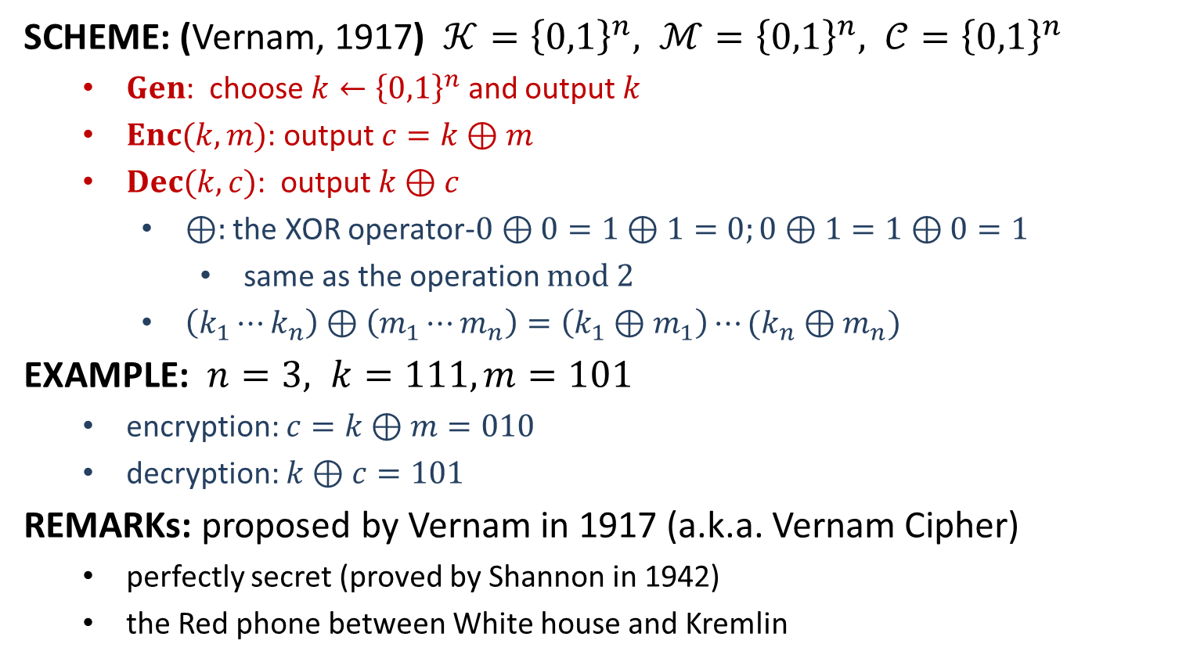
One-Time Pad
SCHEME: (Vernam, 1917) $𝒦={\left\{0,1\right\}}^{n}, ℳ={\left\{0,1\right\}}^{n}, 𝒞={\left\{0,1\right\}}^{n}$
$Gen$: choose $k←{\left\{0,1\right\}}^{n}$ and output $k$
$Enc(k,m)$: output $c=k⊕m$
$Dec(k,c)$: output $k⊕c$
$⊕:$ the XOR operator-$0⊕0=1⊕1=0;0⊕1=1⊕0=1$
same as the operation $mod 2$
$\left(k_{1}⋯k_{n}\right)⊕\left(m_{1}⋯m_{n}\right)=\left(k_{1}⊕m_{1}\right)⋯(k_{n}⊕m_{n})$
EXAMPLE: $n=3, k=111, m=101$
encryption: $c=k⊕m=010$
decryption: $k⊕c=101$
REMARKs: proposed by Vernam in 1917 (a.k.a. Vernam Cipher)
perfectly secret (proved by Shannon in 1942)
the Red phone between White house and Kremlin

Slide 3
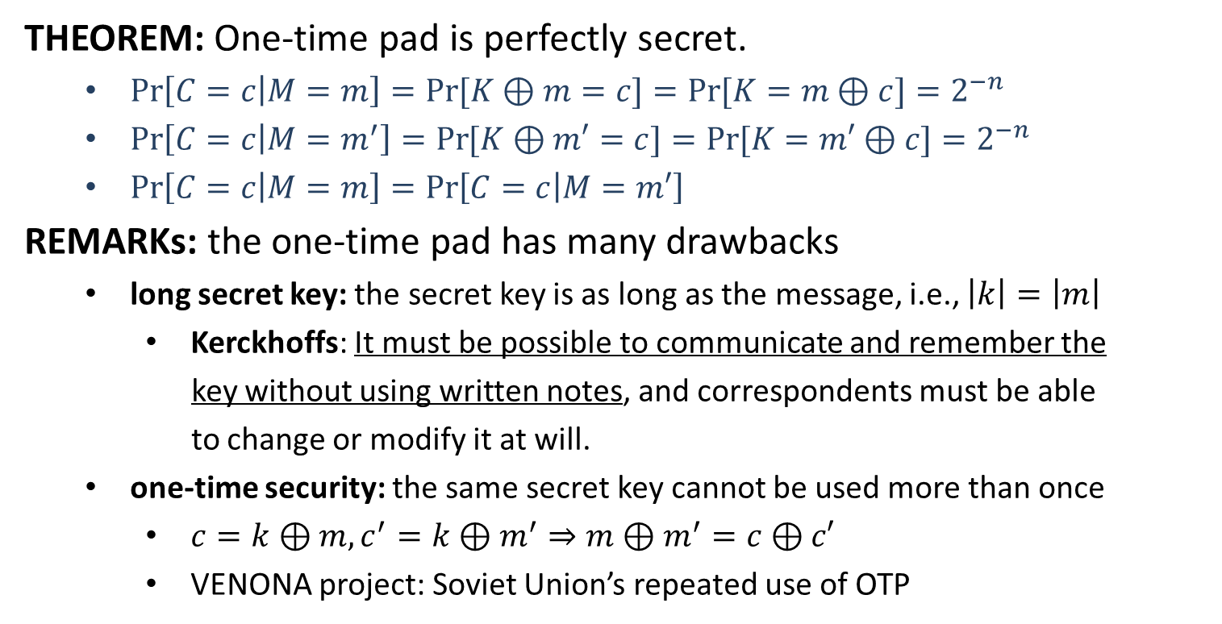
One-Time Pad
THEOREM: One-time pad is perfectly secret.
$\operatorname{Pr}\left[C=c | M=m\right]=\operatorname{Pr}{[K⊕m=c]}=Pr⁡[K=m⊕c]=2^{−n}$
$\operatorname{Pr}\left[C=c | M=m^{′}\right]=\operatorname{Pr}{[K⊕m′=c]}=Pr⁡[K=m′⊕c]=2^{−n}$
$\operatorname{Pr}\left[C=c | M=m\right]=\operatorname{Pr}\left[C=c | M=m′\right]$
REMARKs: the one-time pad has many drawbacks
long secret key: the secret key is as long as the message, i.e., $\left|k\right|=\left|m\right|$
Kerckhoffs: It must be possible to communicate and remember the
key without using written notes, and correspondents must be able
to change or modify it at will.
one-time security: the same secret key cannot be used more than once
$c=k⊕m, c^{′}=k⊕m^{′}⇒m⊕m^{′}=c⊕c′$
VENONA project: Soviet Union’s repeated use of OTP

Slide 4
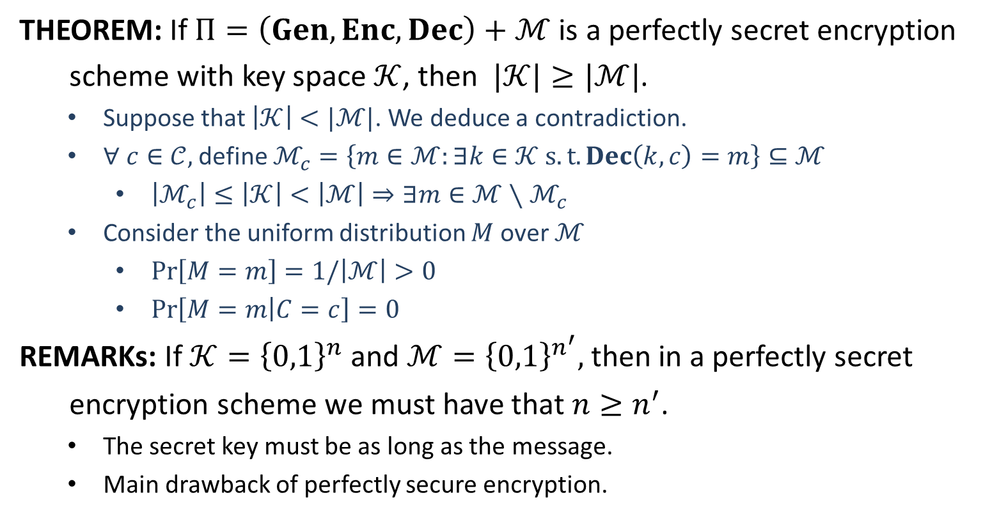
Limitations of Perfect Secrecy
THEOREM: If $Π=\left(Gen, Enc, Dec\right)+ℳ$ is a perfectly secret encryption
scheme with key space $𝒦$, then $|𝒦|≥|ℳ|$.
Suppose that $\left|𝒦\right|<|ℳ|$. We deduce a contradiction.
$∀ c∈𝒞,$ define $ℳ_{c}=\left\{m∈ℳ:∃k∈𝒦 s.t.Dec\left(k,c\right)=m\right\}⊆ℳ$
$\left|ℳ_{c}\right|≤\left|𝒦\right|<\left|ℳ\right|⇒∃m∈ℳ∖ℳ_{c}$
Consider the uniform distribution $M$ over $ℳ$
$\operatorname{Pr}\left[M=m\right]=1/\left|ℳ\right|>0$
$\operatorname{Pr}\left[M=m | C=c\right]=0$
REMARKs: If $𝒦={\left\{0,1\right\}}^{n}$ and $ℳ={\left\{0,1\right\}}^{n^{′}},$then in a perfectly secret
encryption scheme we must have that $n≥n^{′}$.
The secret key must be as long as the message.
Main drawback of perfectly secure encryption.

Slide 6


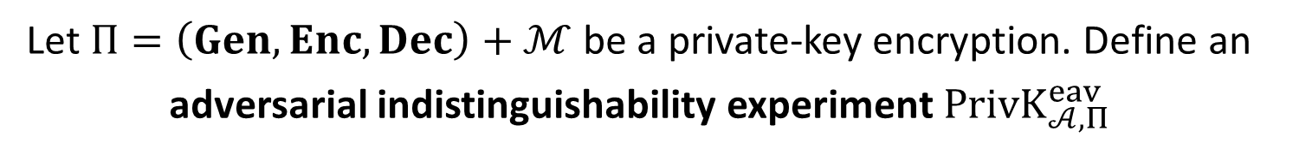



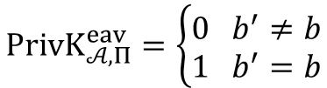





Perfect Indistinguishability
Let $Π=\left(Gen, Enc, Dec\right)+ℳ$ be a private-key encryption. Define an
adversarial indistinguishability experiment $PrivK_{𝒜, Π}^{eav}$
choose $m_{0}, m_{1}∈ ℳ$
$$m_{0},m_{1}$$
$$k←Gen$$
$$b←\{0,1\}$$
$$Challenger$$
$$c←Enc(k,m_{b})$$
$$c$$
$$Adversary 𝒜$$
$$b′$$
$$PrivK_{𝒜, Π}^{eav}=\left\{\begin{aligned}0 b^{′}≠b \\ 1 b^{′}=b\end{aligned}\right.$$
DEFINITION: $Π$is perfectly indistinguishable if for every adversary $𝒜$,
$$\operatorname{Pr}\left[PrivK_{𝒜, Π}^{eav}=1\right]=1/2$$

Slide 7
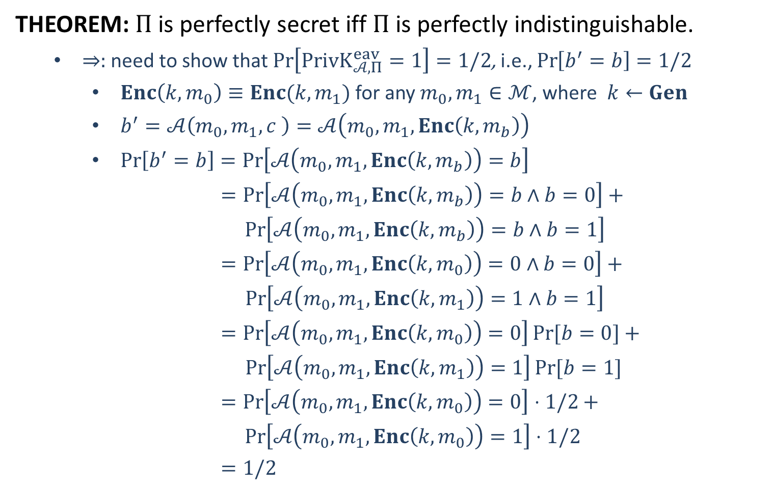
Perfect Indistinguishability
THEOREM: $Π$is perfectly secret iff $Π$ is perfectly indistinguishable.
$⇒:$ need to show that $\operatorname{Pr}\left[PrivK_{𝒜, Π}^{eav}=1\right]=1/2$, i.e., $\operatorname{Pr}\left[b^{′}=b\right]=1/2$
$Enc\left(k,m_{0}\right)≡Enc(k,m_{1})$ for any $m_{0},m_{1}∈ℳ$, where $k←Gen$
$b^{′}=𝒜\left(m_{0},m_{1},c \right)=𝒜\left(m_{0},m_{1},Enc\left(k,m_{b}\right)\right)$
$\operatorname{Pr}\left[b^{′}=b\right]=\operatorname{Pr}\left[𝒜\left(m_{0},m_{1},Enc\left(k,m_{b}\right)\right)=b\right]$
$=\operatorname{Pr}\left[𝒜\left(m_{0},m_{1},Enc\left(k,m_{b}\right)\right)=b∧b=0\right]+$
$\operatorname{Pr}\left[𝒜\left(m_{0},m_{1},Enc\left(k,m_{b}\right)\right)=b∧b=1\right]$
$=\operatorname{Pr}\left[𝒜\left(m_{0},m_{1},Enc\left(k,m_{0}\right)\right)=0∧b=0\right]+$
$\operatorname{Pr}\left[𝒜\left(m_{0},m_{1},Enc\left(k,m_{1}\right)\right)=1∧b=1\right]$
$=\operatorname{Pr}\left[𝒜\left(m_{0},m_{1},Enc\left(k,m_{0}\right)\right)=0\right]Pr⁡[b=0]+$
$\operatorname{Pr}\left[𝒜\left(m_{0},m_{1},Enc\left(k,m_{1}\right)\right)=1\right]Pr⁡[b=1]$
$=\operatorname{Pr}\left[𝒜\left(m_{0},m_{1},Enc\left(k,m_{0}\right)\right)=0\right]⋅1/2+$
$\operatorname{Pr}\left[𝒜\left(m_{0},m_{1},Enc\left(k,m_{0}\right)\right)=1\right]⋅1/2$
$=1/2$

Slide 8
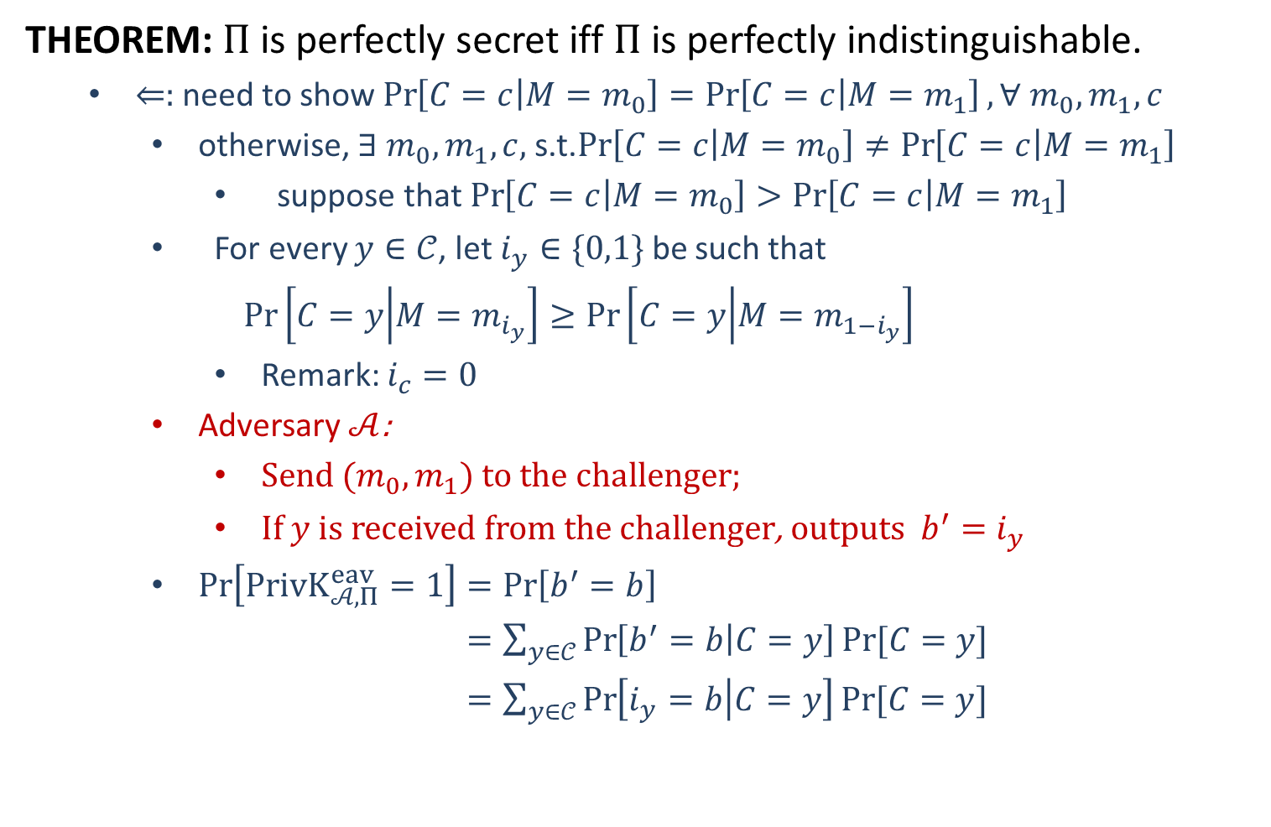
Perfect Indistinguishability
THEOREM: $Π$is perfectly secret iff $Π$ is perfectly indistinguishable.
$⇐:$ need to show $\operatorname{Pr}\left[C=c | M=m_{0}\right]=\operatorname{Pr}\left[C=c | M=m_{1}\right], ∀ m_{0},m_{1},c$
otherwise, $∃ m_{0},m_{1},c,$s.t.$\operatorname{Pr}\left[C=c | M=m_{0}\right]≠\operatorname{Pr}\left[C=c | M=m_{1}\right]$
suppose that $\operatorname{Pr}\left[C=c | M=m_{0}\right]>\operatorname{Pr}\left[C=c | M=m_{1}\right]$
For every $y∈𝒞$, let $i_{y}∈\{0,1\}$ be such that
$$\operatorname{Pr}\left[C=y | M=m_{i_{y}}\right]≥\operatorname{Pr}\left[C=y | M=m_{1−i_{y}}\right]$$
Remark: $i_{c}=0$
Adversary $𝒜$:
Send $(m_{0},m_{1})$ to the challenger;
If $y$ is received from the challenger, outputs $b^{′}=i_{y}$
$\operatorname{Pr}\left[PrivK_{𝒜, Π}^{eav}=1\right]=\operatorname{Pr}\left[b^{′}=b\right]$
$=\sum_{y∈𝒞}{\operatorname{Pr}\left[b^{′}=b | C=y\right]Pr⁡[C=y]}$
$=\sum_{y∈𝒞}{\operatorname{Pr}\left[i_{y}=b | C=y\right]Pr⁡[C=y]}$

Slide 9
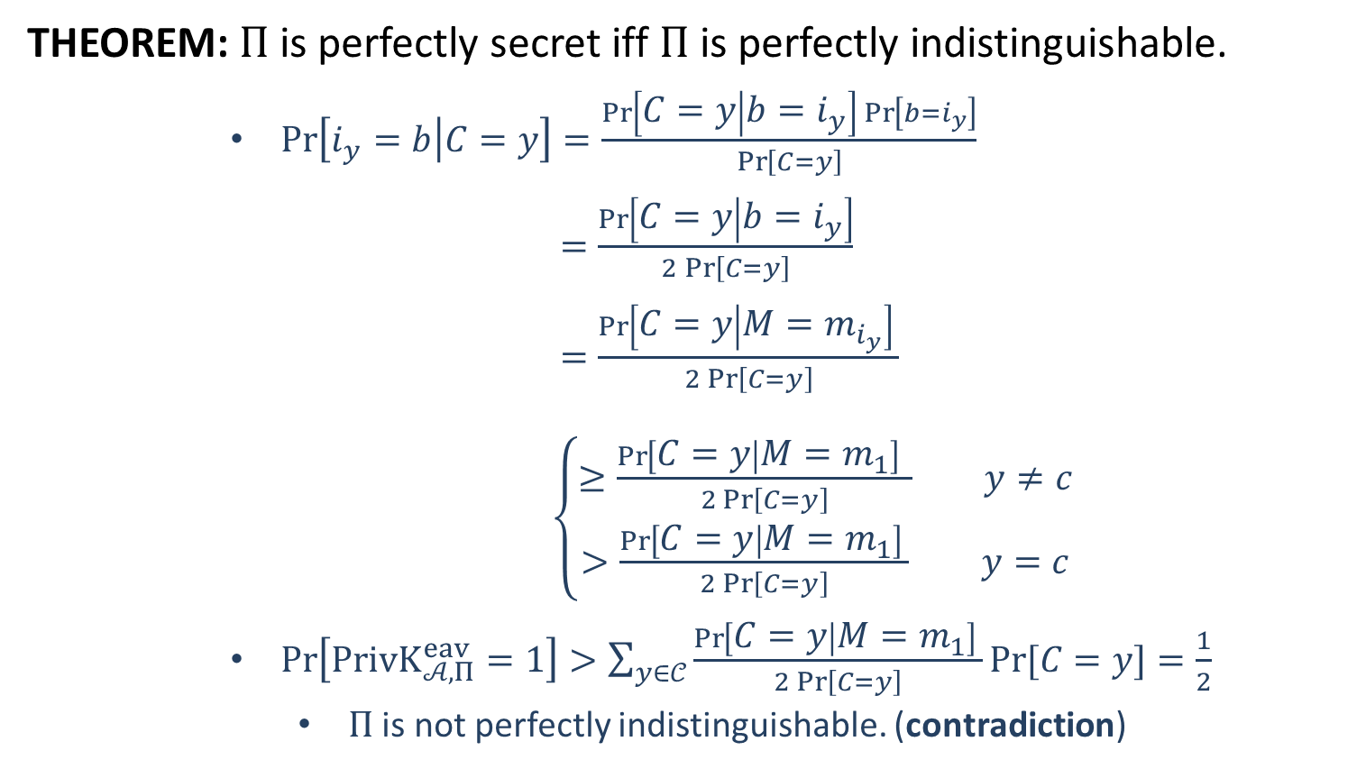
Perfect Indistinguishability
THEOREM: $Π$is perfectly secret iff $Π$ is perfectly indistinguishable.
$\operatorname{Pr}\left[i_{y}=b | C=y\right]=\frac{\operatorname{Pr}\left[C=y | b=i_{y}\right]\operatorname{Pr}\left[b=i_{y}\right]}{\operatorname{Pr}\left[C=y\right]}$
$=\frac{\operatorname{Pr}\left[C=y | b=i_{y}\right]}{2\operatorname{Pr}\left[C=y\right]}$
$=\frac{\operatorname{Pr}\left[C=y | M=m_{i_{y}}\right] }{2\operatorname{Pr}\left[C=y\right]}$
$\left\{\begin{aligned}≥\frac{\operatorname{Pr}\left[C=y | M=m_{1}\right] }{2\operatorname{Pr}\left[C=y\right]} y≠c \\ >\frac{\operatorname{Pr}\left[C=y | M=m_{1}\right] }{2\operatorname{Pr}\left[C=y\right]} y=c\end{aligned}\right.$
$\operatorname{Pr}\left[PrivK_{𝒜, Π}^{eav}=1\right]>\sum_{y∈𝒞}{\frac{\operatorname{Pr}\left[C=y | M=m_{1}\right] }{2\operatorname{Pr}\left[C=y\right]}Pr⁡[C=y]}=\frac{1}{2}$
$Π$ is not perfectly indistinguishable. (contradiction)

Slide 10
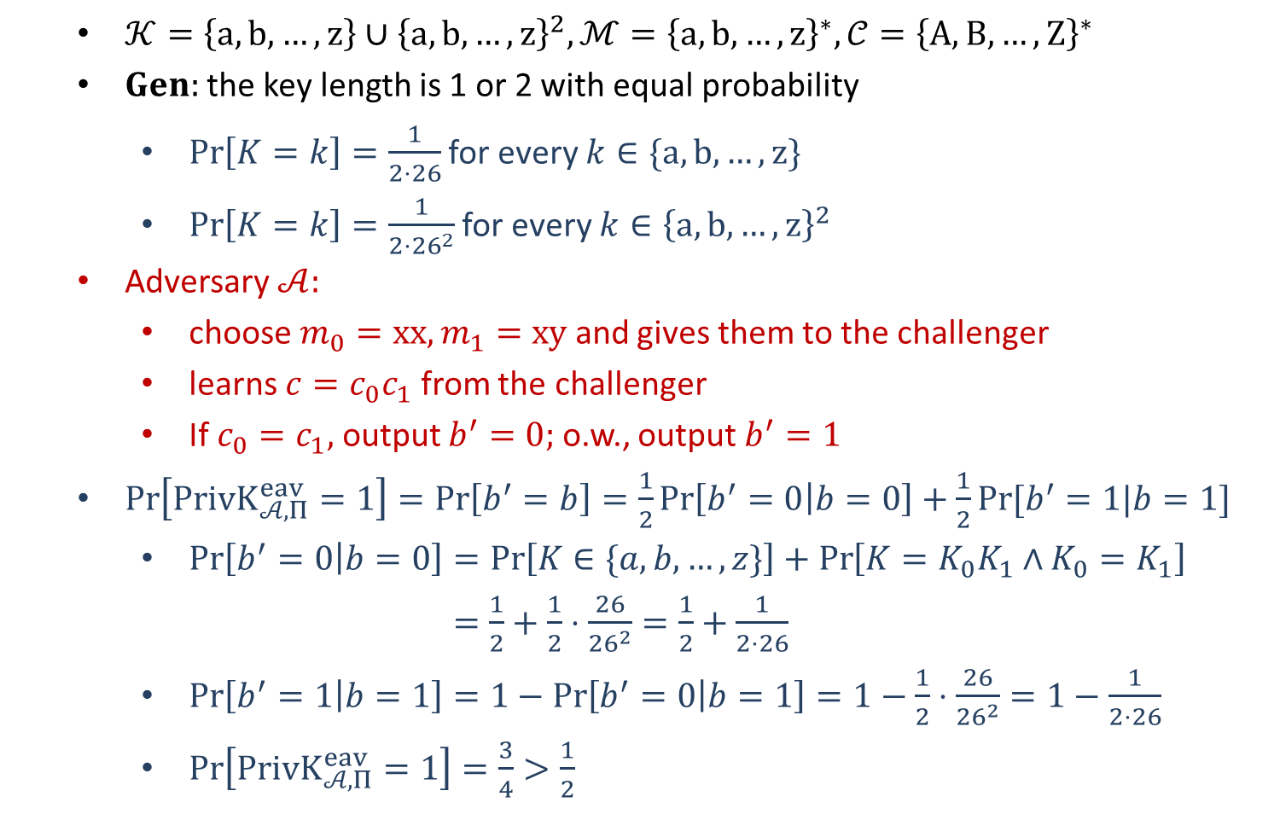
Example: Vigenère Cipher
$𝒦=\left\{a,b,…,z\right\}∪{\left\{a,b,…,z\right\}}^{2}, ℳ={\left\{a,b,…,z\right\}}^{∗}, 𝒞={\left\{A,B,…,Z\right\}}^{∗}$
$Gen:$the key length is 1 or 2 with equal probability
$\operatorname{Pr}\left[K=k\right]=\frac{1}{2⋅26}$ for every $k∈\{a,b,…,z\}$
$\operatorname{Pr}\left[K=k\right]=\frac{1}{2⋅{26}^{2}}$ for every $k∈{\left\{a,b,…,z\right\}}^{2}$
Adversary $𝒜:$
choose $m_{0}=xx, m_{1}=xy$ and gives them to the challenger
learns $c=c_{0}c_{1}$ from the challenger
If $c_{0}=c_{1},$ output $b^{′}=0;$o.w., output $b^{′}=1$
$\operatorname{Pr}\left[PrivK_{𝒜, Π}^{eav}=1\right]=\operatorname{Pr}\left[b^{′}=b\right]=\frac{1}{2}\operatorname{Pr}\left[b^{′}=0 | b=0\right]+\frac{1}{2}Pr⁡[b^{′}=1|b=1]$
$\operatorname{Pr}\left[b^{′}=0 | b=0\right]=\operatorname{Pr}\left[K∈\{a,b,…,z\}\right]+\operatorname{Pr}\left[K=K_{0}K_{1}∧K_{0}=K_{1}\right]$
$=\frac{1}{2}+\frac{1}{2}⋅\frac{26}{{26}^{2}}=\frac{1}{2}+\frac{1}{2⋅26}$
$\operatorname{Pr}\left[b^{′}=1 | b=1\right]=1−\operatorname{Pr}\left[b^{′}=0 | b=1\right]=1−\frac{1}{2}⋅\frac{26}{{26}^{2}}=1−\frac{1}{2⋅26}$
$\operatorname{Pr}\left[PrivK_{𝒜, Π}^{eav}=1\right]=\frac{3}{4}>\frac{1}{2}$
not perfectly indistinguishable!

Slide 11
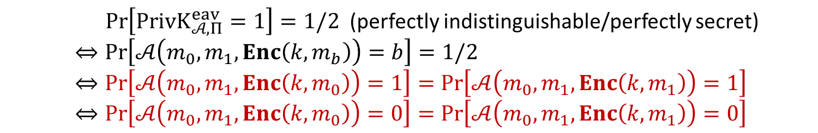
Perfect Indistinguishability
Let $Π=\left(Gen, Enc, Dec\right)+ℳ$ be a private-key encryption. Define an
adversarial indistinguishability experiment $PrivK_{𝒜, Π}^{eav}$
choose $m_{0}, m_{1}∈ ℳ$
$$m_{0},m_{1}$$
$$k←Gen$$
$$b←\{0,1\}$$
$$Challenger$$
$$c←Enc(k,m_{b})$$
$$c$$
$$Adversary 𝒜$$
$$b′$$
$$PrivK_{𝒜, Π}^{eav}=\left\{\begin{aligned}0 b^{′}≠b \\ 1 b^{′}=b\end{aligned}\right.$$
$\operatorname{Pr}\left[PrivK_{𝒜, Π}^{eav}=1\right]=1/2$ (perfectly indistinguishable/perfectly secret)
$⇔\operatorname{Pr}\left[𝒜\left(m_{0},m_{1},Enc\left(k,m_{b}\right)\right)=b\right]=1/2$
$⇔\operatorname{Pr}\left[𝒜\left(m_{0},m_{1},Enc\left(k,m_{0}\right)\right)=1\right]=\operatorname{Pr}\left[𝒜\left(m_{0},m_{1},Enc\left(k,m_{1}\right)\right)=1\right]$
$⇔\operatorname{Pr}\left[𝒜\left(m_{0},m_{1},Enc\left(k,m_{0}\right)\right)=0\right]=\operatorname{Pr}\left[𝒜\left(m_{0},m_{1},Enc\left(k,m_{1}\right)\right)=0\right]$

